Slide 1
EV3 LV Topology
Matthew Whitworth

Slide 2
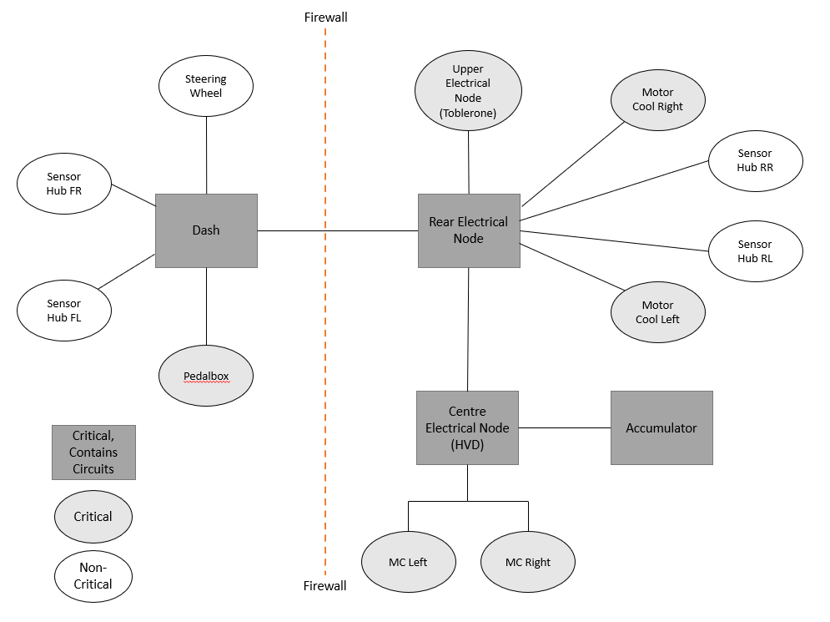
EV3’s Nervous System

Slide 3
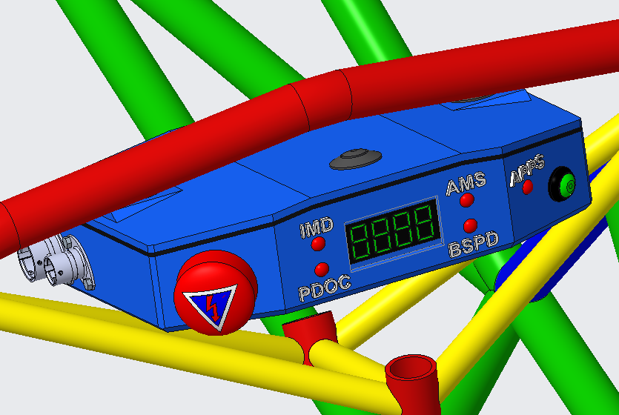
Forward Electrical Node - Dashboard
Driver interface, shows fault status’
Reads critical pedal box sensors
Ready to drive button and driver E-Stop

Slide 4
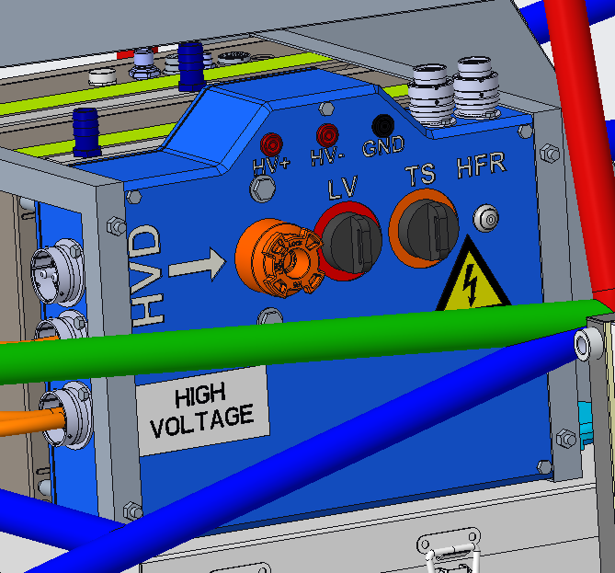
Centre Electrical Node - HVD
HV to LV interface
Startup/shutdown controls for vehicle
High Voltage Disconnect and master switches

Slide 5

Rear Electrical Node – Brake Light
Connector hub, alleviated connectors from HVD
Houses brakelight and MOTEC
Positioned above drivetrain assembly at rear of car

Slide 6
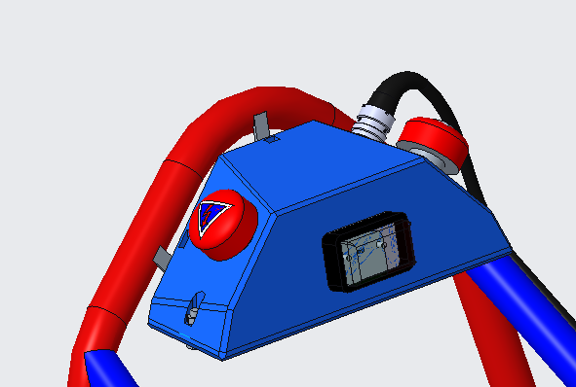
Upper Electrical Node - Toblerone
Shows Tractive System state
Pitcew/marshall E-Stops and TSAL light
Located at top of roll hoop

